Slide 1



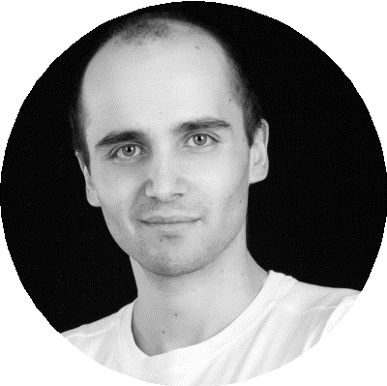


Slide 2






Slide 3



Slide 4


Slide 5








Slide 6





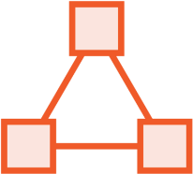

Slide 7



Slide 8
interface LoginService{
void signIn();
void signOut();
void updateRememberMeCookie(); User getUserDetails();
void setSessionExpiration(int seconds); void validateToken(Jwt token);
…
}

Slide 9

class GoogleLoginService implements LoginService{
…
public void updateRememberMeCookie(){
throw new UnsupportedOperationException();
}
public void setSessionExpiration(int seconds){
throw new UnsupportedOperationException();
}

Slide 10
interface ShoppingCart{
void addItem(Item item); void removeItem(Item item);
void processPayment();
bool checkItemInStock(Item item);
}

Slide 11

class ShoppingCartImpl implements ShoppingCart{
public void processPayment(){
PaymentService ps = new PaymentService(); ps.pay(this.totalAmount);
User user = UserService.getUserForTransaction(); EmailService emailService = new EmailService(); emailService.notify(user);
}
}

Slide 12




public abstract class Account{
abstract double getBalance();
abstract void processLocalPayment(double amnt); abstract void processInternationalPayment(double amnt);
}

Slide 13

public class SchoolAccount extends Account{
…
void processInternationalPayment(double amount){
// Do nothing. Better than throwing an error, right?
}
}

Slide 14

















Slide 15







Slide 16






Slide 17



interface Account{
double getBalance();
void processLocalPayment(double amount);
void processInternationalPayment(double amount);
}

Slide 18



interface BaseAccount{
double getBalance();
}
interface LocalMoneyTransferCapability{ void processLocalPayment(double amount);
}
interface IntlMoneyTransferCapability{
void processInternationalPayment(double amount);
}

Slide 19

public class SchoolAccount
implements Account, LocalMoneyTransferCapability{
// We can now correctly implement all the methods
}

Slide 20

public class InternationalLoanService
implements IntlMoneyTransferCapability {
…
public void processInternationalPayment(double amount){
// Money transfer logic here
}
}

Slide 21



-
-

Slide 22





-

Slide 23


Slide 24


